Slide 1




NEXT GEN EMPLOYABILITY PROGRAM
Creating a future-ready workforce
Team Members
College Name
Student Name :THIRISHA N
Student ID :au513521104051
Annai Mira College of Engineering and Technology

Slide 2

CAPSTONE PROJECT SHOWCASE
Project Title
Building Bus Reservation System using Python and Django
Abstract | Problem Statement | Project Overview | Proposed Solution | Technology Used | Modelling & Results | Conclusion

Slide 3
Abstract
The Bus Reservation System is a Python and Django-based project aimed at streamlining the booking process for bus services.
It allows users to search for available routes, select seats, and make reservations online.
The system facilitates efficient management of bookings, with features for admins to add/edit routes, manage schedules, and view reservation details.
Users can register accounts, access booking history, and receive confirmation emails.
Integration of secure payment gateways ensures smooth transactions.
Utilizing Django's MVC architecture, the system offers scalability, flexibility, and robust security.
This project aims to enhance the user experience and optimize bus service operations through modern web technologies.

Slide 4
Problem Statement
Create a Bus Reservation System using Python and Django to facilitate seamless booking and management of bus tickets.
The system should allow users to search for buses based on various criteria like destination, departure time, and bus type.
Users should be able to view available seats, select seats, and make bookings securely.
Administrators should have functionalities to manage buses, routes, and bookings.
The system should ensure data integrity, security, and provide a user-friendly interface for both users and administrators.
Additionally, it should generate booking confirmations and support cancellations and refunds.

Slide 5
Project Overview
The Bus Reservation System aims to automate the process of booking seats on buses.
Users can search for available buses based on destination and date, select seats, make reservations, and view their booking history.
Admins can manage buses, routes, and bookings.
Challenges include designing a user-friendly interface, implementing secure authentication and payment systems, optimizing database queries for efficiency, handling concurrency and synchronization issues during seat booking, and ensuring scalability for handling a large number of users and simultaneous transactions.
Integration with external APIs for real-time data updates and notifications also presents a technical hurdle.

Slide 6
Proposed Solution
.
The proposed solution for the Bus Reservation System involves using Python and Django framework.
Django provides a robust foundation for building web applications, offering features like authentication, ORM for database interactions, and routing.
The system will allow users to search for available buses, view schedules, select seats, and make reservations securely.
Admin functionalities will include managing buses, schedules, and user reservations.
Utilizing Django's built-in security measures and scalability options, this project aims to deliver a user-friendly and efficient platform for bus reservation management.
Source :

Slide 7

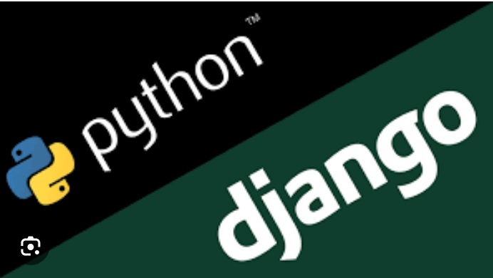
Technology Used
Front-end
Back-end
Source :

Slide 8
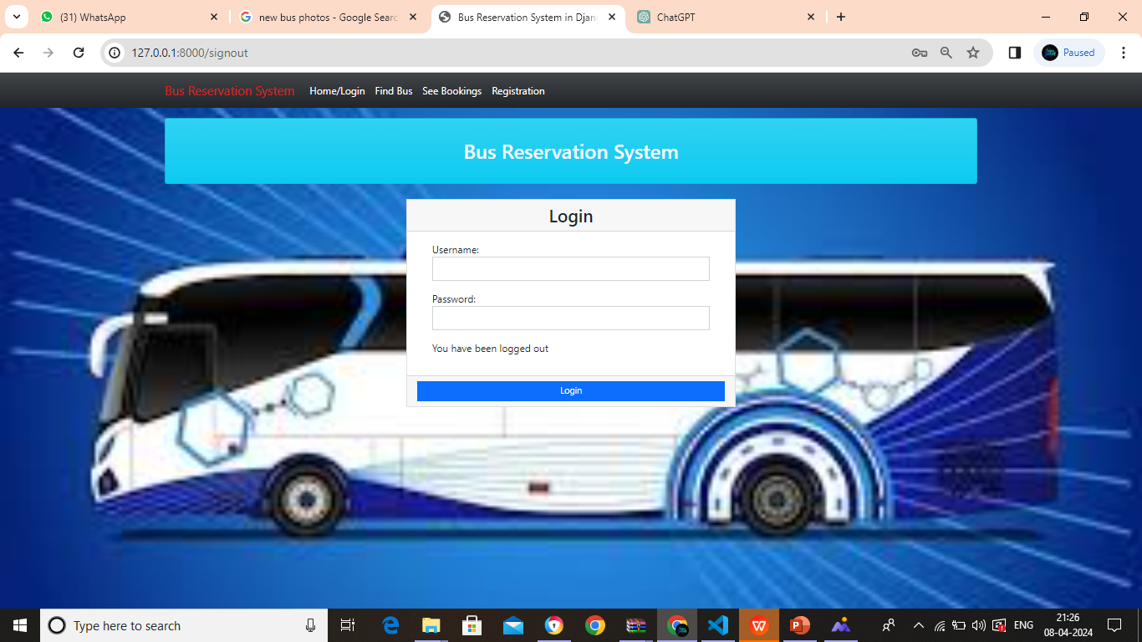
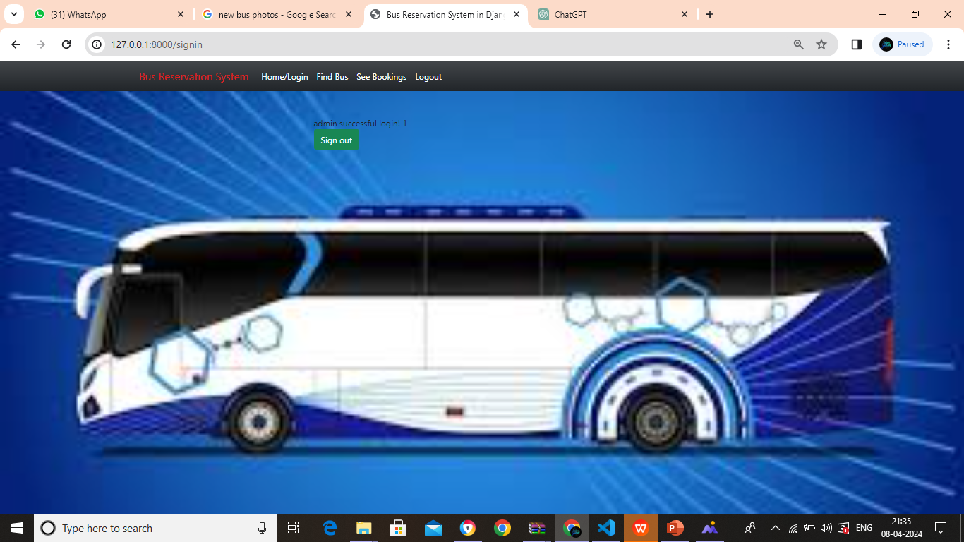
Modelling & Results

Slide 9
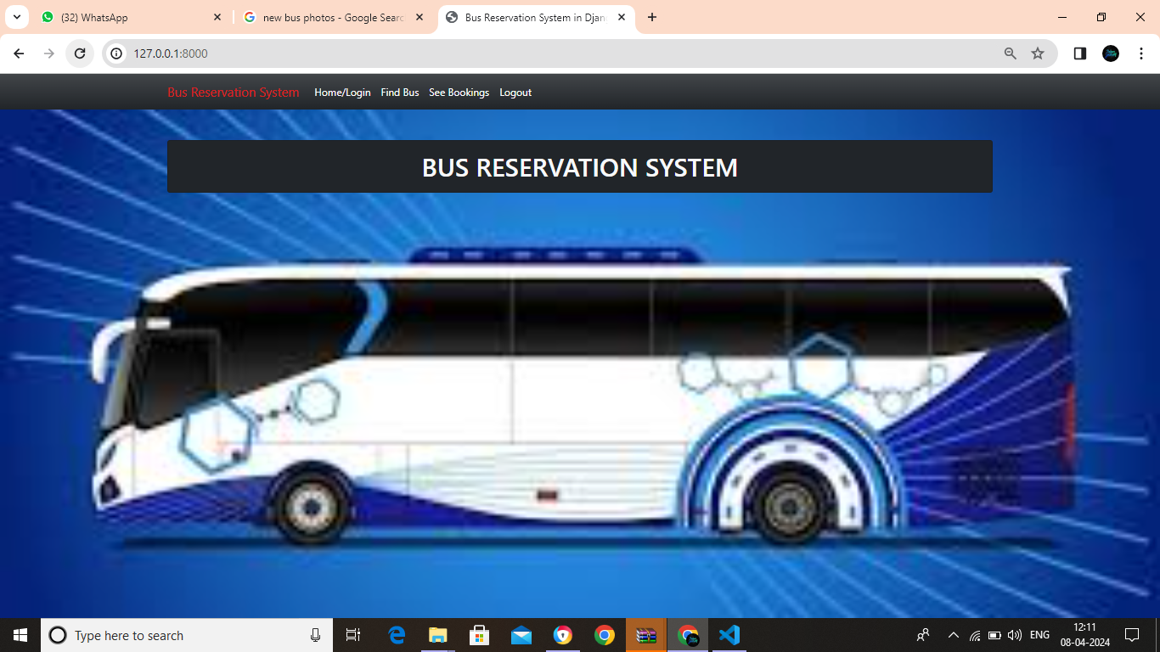
Homepage

Slide 10
Login page

Slide 11
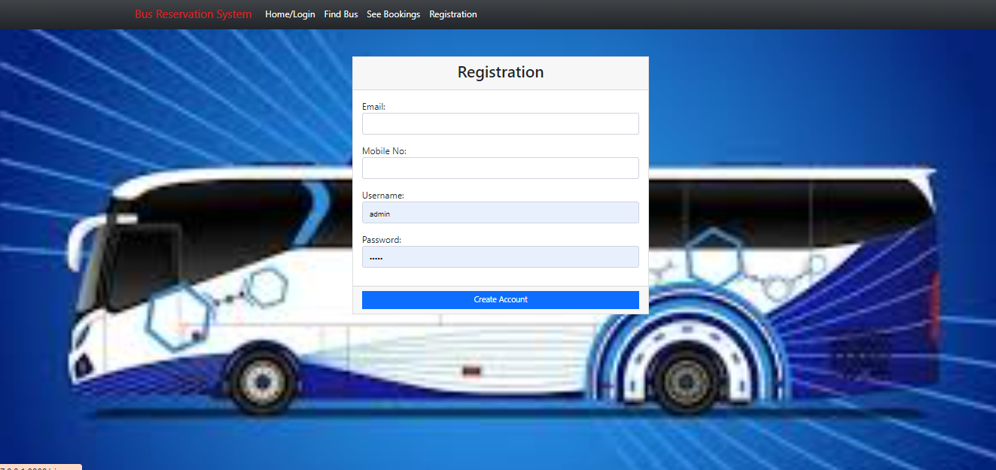
Registration page

Slide 12
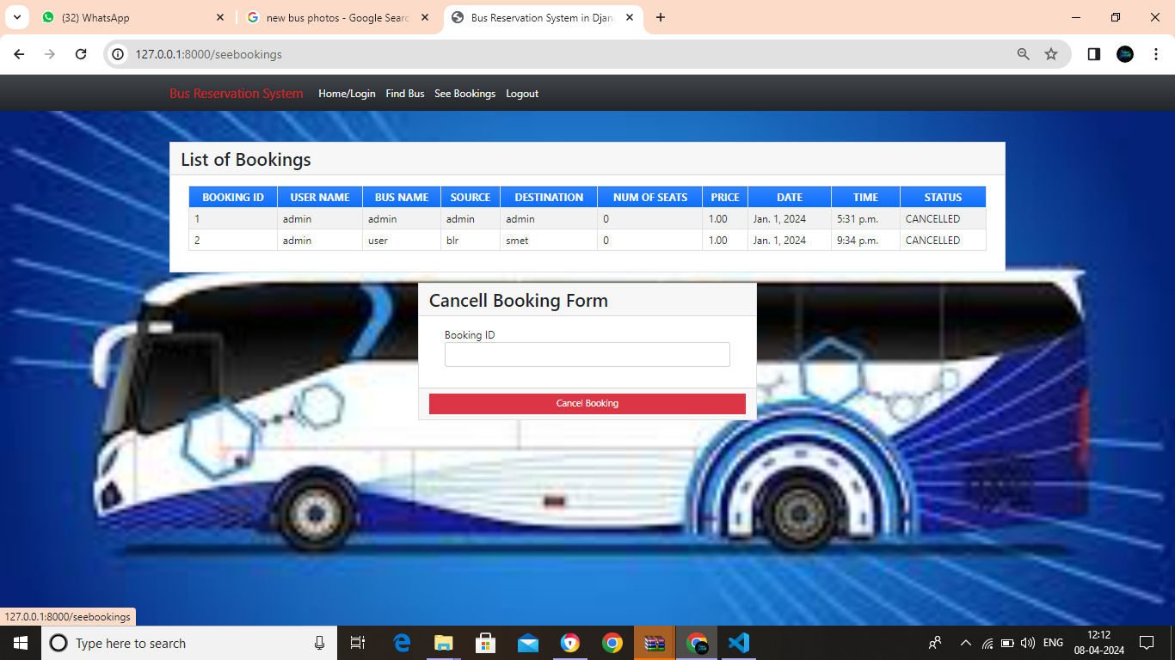
See bookings page

Slide 13
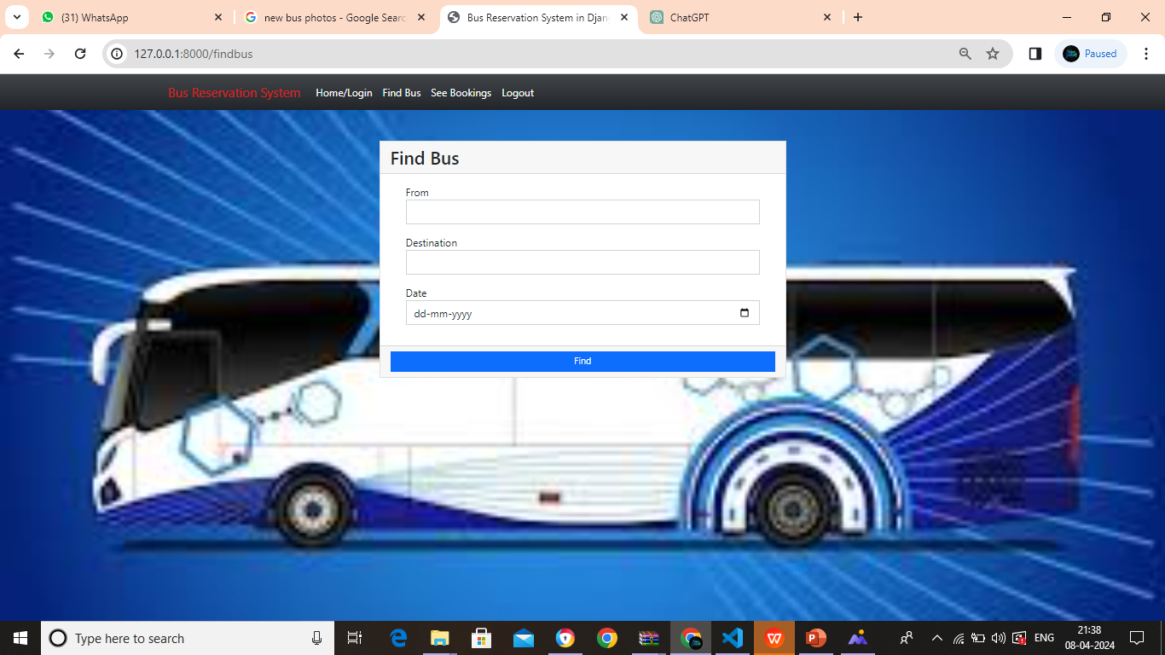
Find bus page

Slide 14
Future Enhancements:
1. Integration of real-time GPS tracking for buses, allowing passengers to track their bus's location.
2. Implementation of a mobile application for convenient booking and management of reservations.
3. Addition of a feedback and rating system for both passengers and bus operators.
4. Integration of AI-powered chatbots for customer support and assistance.
5. Expansion to support multi-language and multi-currency options for international travelers.

Slide 15
Conclusion
In conclusion, developing a Bus Reservation System using Python and Django has proven to be an efficient and effective solution for managing bus bookings.
Through Django's robust framework and Python's versatility, we've created a user-friendly platform that streamlines the reservation process for both customers and administrators.
By leveraging Django's built-in features like ORM and authentication, we ensured data security and scalability.
Additionally, integrating payment gateways and real-time notifications enhances user experience and operational efficiency.
Overall, this project demonstrates the power of Python and Django in developing practical and scalable solutions for the transportation industry.
Source :

Slide 16
Thank You!
Notes:
Thank You !!

